Slide 1
Javascript development frameworks
Angular Observables

Slide 2
Course objectives
Introduction to Javascript. Overview
Basic http handling
Building a web server with NodeJS
NodeJS. Request and response, HTML templates, JSON data
NodeJS routing
ExpressJS
NPM, build tools
File management. Promises
Introduction to TypeScript
Introduction to Angular 2
Angular modules, applications, components
Angular services
Angular templates
Observables in Angular
Routing in Angular

Slide 3
What are Observables
Observables are used for asynchronous computations
Observables are proxies for values
An Observable is a first class object holding the state of async operations
A pattern implemented by varous 3rd party libraries (Rx, baconjs, kevirjs etc.)

Slide 4
Observables in Angular
Angular has built-in support for Observables in many APIs of the framework.
Http and JsonP
Forms
Change Detection Optimization
Based on Rx library, but supposed to work with other implementations

Slide 5
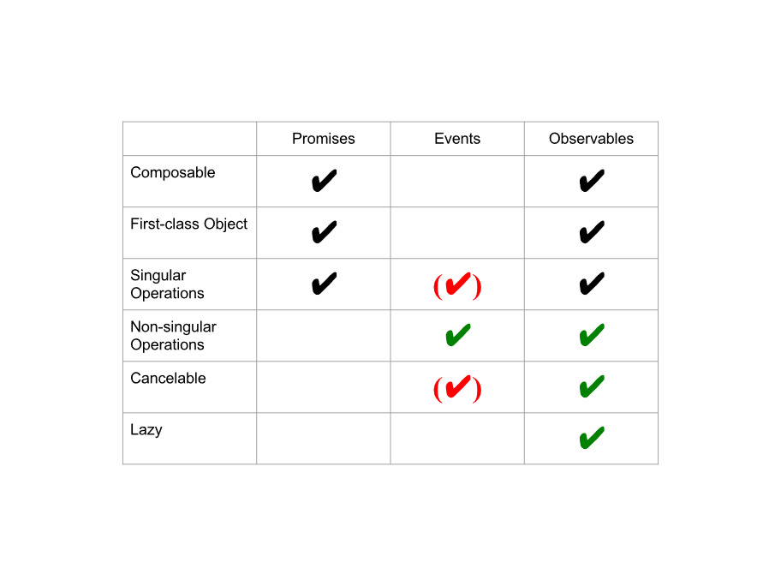
Async Abstractions

Slide 6
Observer<T>
An observer is an object that receives notifications from a source.
interface Observer<T> {
next: (value: T) => void;
error: (err: any) => void;
complete: () => void;
}

Slide 7
Creating Observables
Observables can be created using Observable.create
import { Observable } from 'rxjs/Observable';
let myObservable = Observable
.create((observer) => { observer.next('Observables rock!'); observer.complete();
});

Slide 8
Creating Observables
import { Observable } from 'rxjs/Observable';
let myObservable = Observable
.create((observer) => {
observer.next('Observables rock!');
observer.next('They can emit multiple values');
observer.next('They don't even have to complete');
});

Slide 9
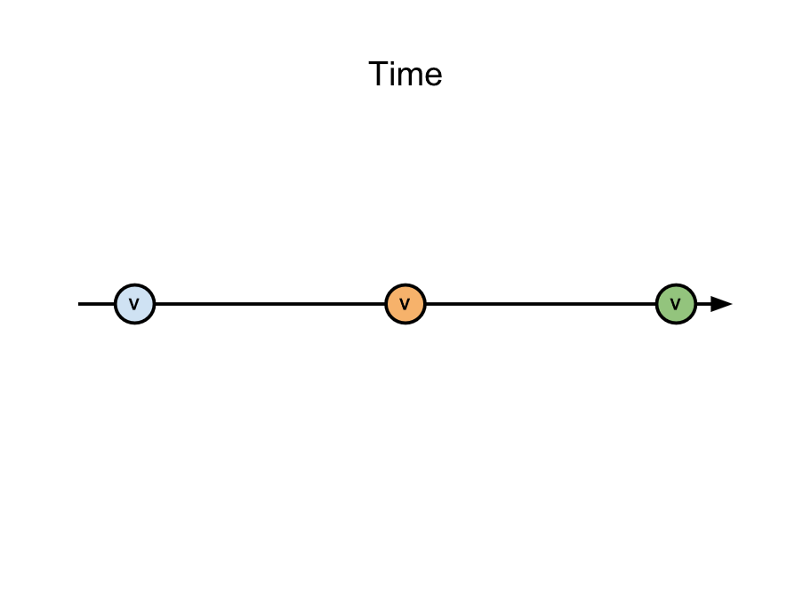
Creating Observables

Slide 10
Consuming observables
We consume Observables by calling .subscribe() on them
myObservable.subscribe(
val => console.log(val),
err => console.error(err),
() => console.log('completed')
);
// Observables rock!
// completed

Slide 11
Unsubscribing
We unsubscribe Observables by calling .unsubscribe() on the returned disposable.
let disposable = myObservable.subscribe(
val => console.log(val)
);
disposable.unsubscribe();

Slide 12
Push vs Pull
Observables are very much like Lists
Difference: Values are retrieved push based instead of pull based
Hence familiar operators: map, filter, merge,...

Slide 13
Map(fn)
Projects each element of an observable sequence into a new form
import { of } from 'rxjs/observable/of';
import { map } from 'rxjs/operators';
let myObservable = of(1, 2, 3);
myObservable.pipe(map(val => val * 10));

Slide 14
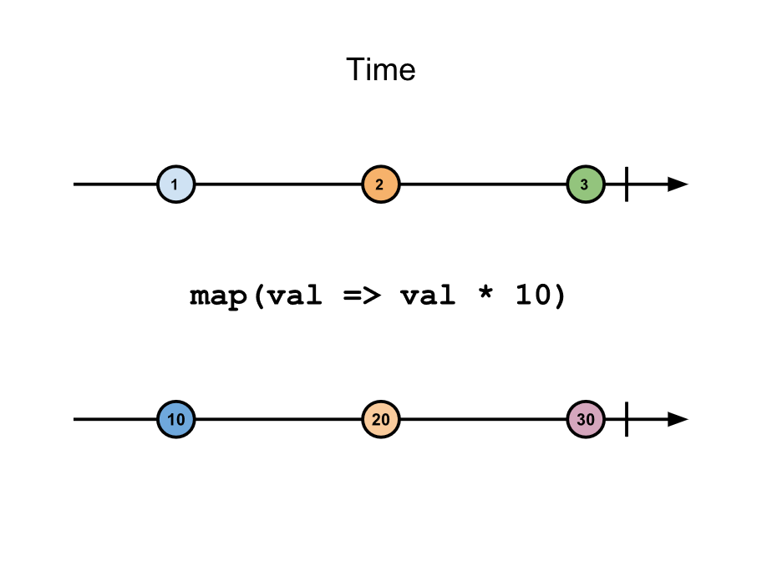
Map(fn)

Slide 15
debounceTime(ms)
Only emit item if a particular time span has passed without it emitting another item.
import { Observable } from 'rxjs/Observable';
import { debounceTime } from 'rxjs/operators';
let myObservable = Observable
.create(observer => {
observer.next(1);
setTimeout(() => observer.next(2), 110);
setTimeout(() => observer.next(3), 150);
setTimeout(() => observer.next(4), 200);
setTimeout(() => observer.next(5), 350); });
myObservable.pipe(debounceTime(100))
.subscribe(val => console.log(val));

Slide 16
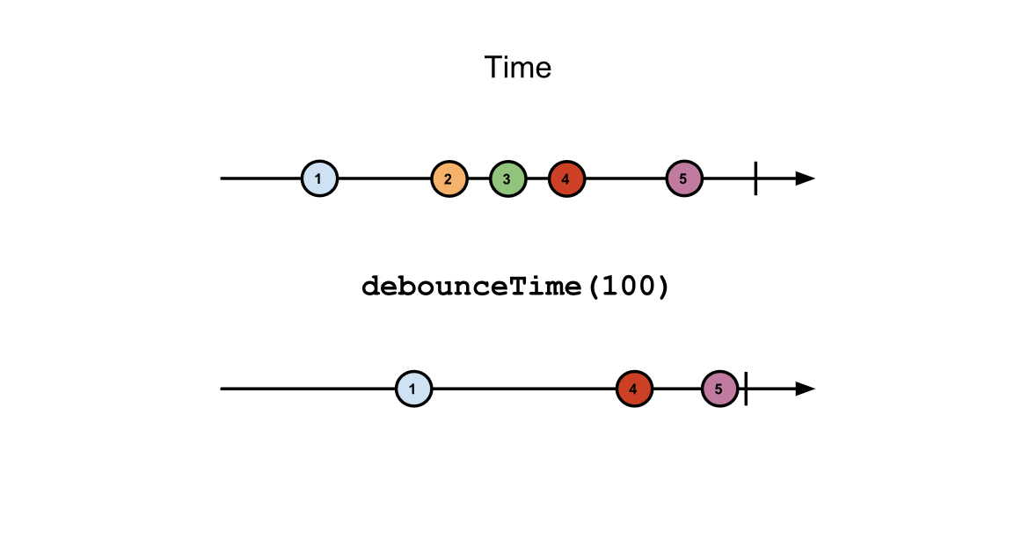
debounceTime(ms)

Slide 17
distinctUntilChanged()
Returns an observable sequence that contains only distinct contiguous elements
import { of } from 'rxjs/observable/of';
import { distinctUntilChanged } from 'rxjs/operators';
let myObservable = of(1, 2, 2, 3);
myObservable.pipe(distinctUntilChanged());

Slide 18
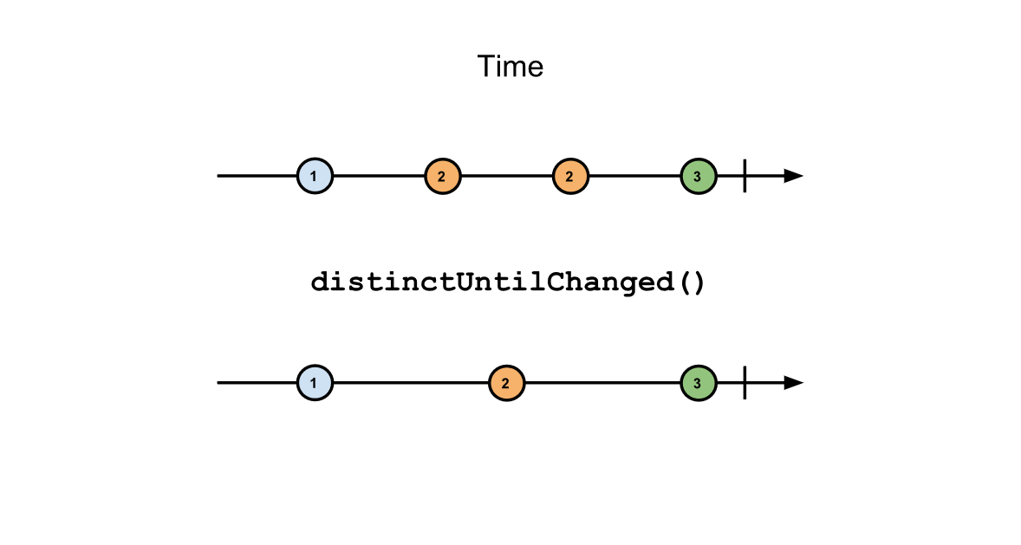
distinctUntilChanged()

Slide 19
Subject<T>
Implements both Observable and Observer
import {Subject} from 'rxjs/Subject';
@Component(...)
class ContactsListComponent implements OnInit {
...
private terms$ = new Subject<string>();
ngOnInit() {
...
this.terms$.pipe( debounceTime(400), distinctUntilChanged() ).subscribe(term => this.search(term));
}
}

Slide 20
Subject<T>
<mat-toolbar>
<mat-input-container>
<input matInput (input)="terms$.next($event.target.value)">
</mat-input-container>
</mat-toolbar>
<mat-list>
...
</mat-list>

Slide 21
flatMap(fn)
Transform the items emitted by an Observable into Observables, then flatten the emissions into a single Observable.
let myObservable = of(
Observable.of(1, 2),
Observable.of(3, 4),
Observable.of(5, 6)
);
myObservable.pipe(flatMap(x => x));

Slide 22
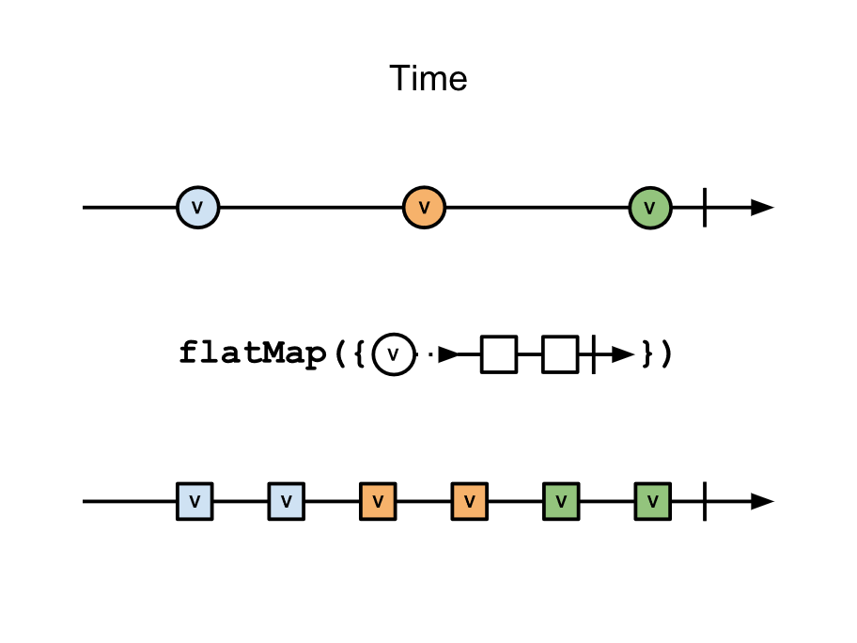
flatMap(fn)

Slide 23
switchMap(fn)
Transform the items emitted into Observables, and mirror those items emitted by the most-recently transformed Observable.
let myObservable = of(
of(1, 2).pipe(delay(1)),
of(3, 4).pipe(delay(1)),
of(5, 6).pipe(delay(1))
);
myObservable.pipe(switchMap(x => x));

Slide 24
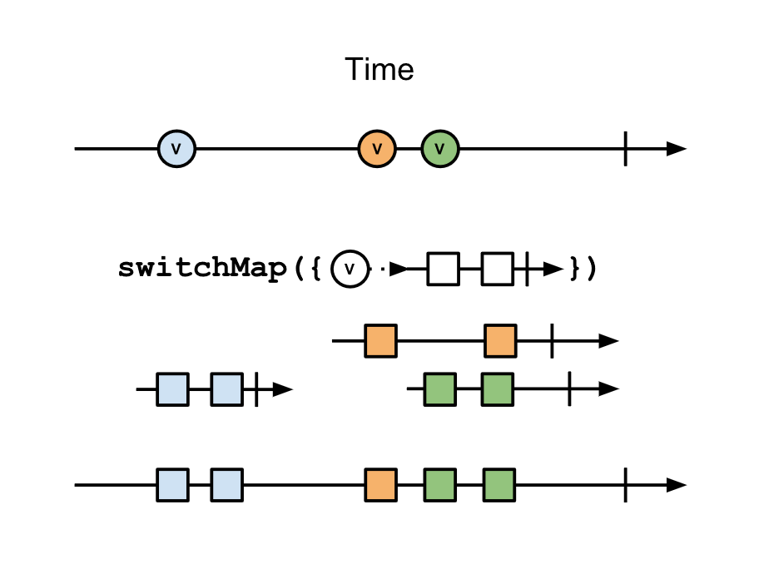
switchMap(fn)

Slide 25
Merge(obs)
Combine multiple Observables into one by merging their emissions.
let myObservable = of(1, 2, 3);
let otherObservable = of(10, 20, 30);
myObservable.pipe(merge(otherObservable));

Slide 26
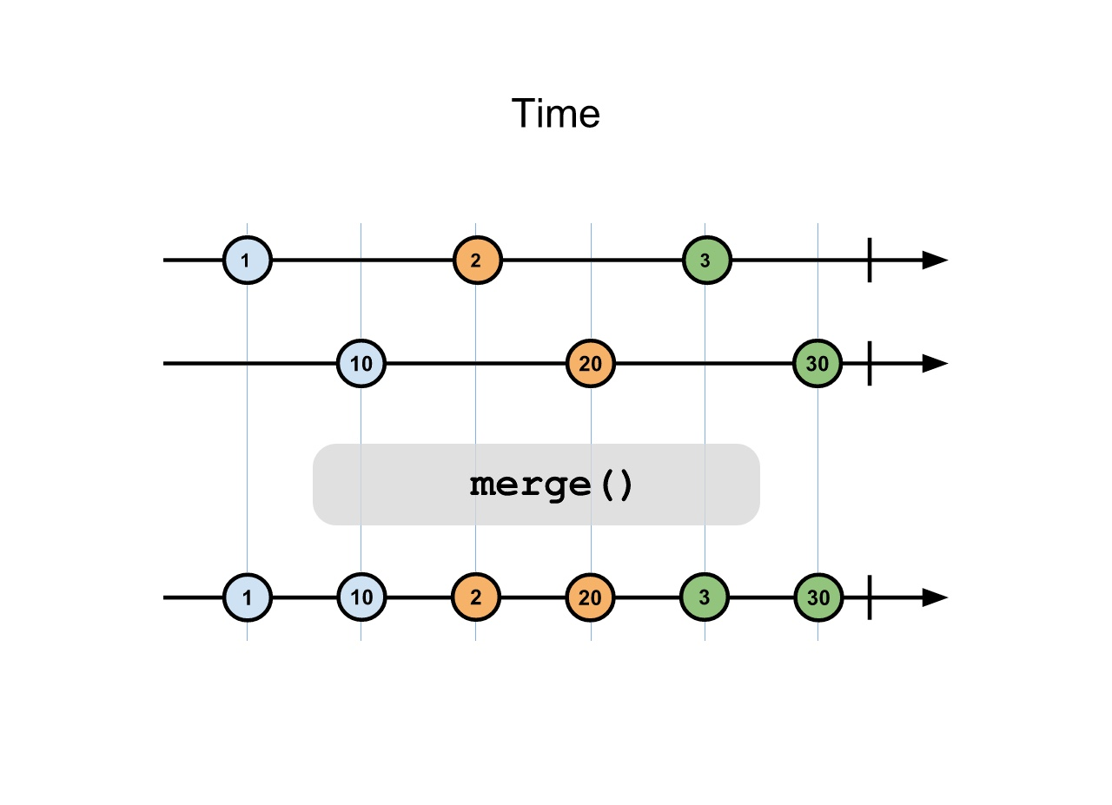
Merge(obs)

Slide 27
Filter(fn)
Filters the elements of an observable sequence based on a predicate.
let myObservable = of(1, 2, 3);
myObservable.pipe(filter(val => val % 2 === 0));

Slide 28
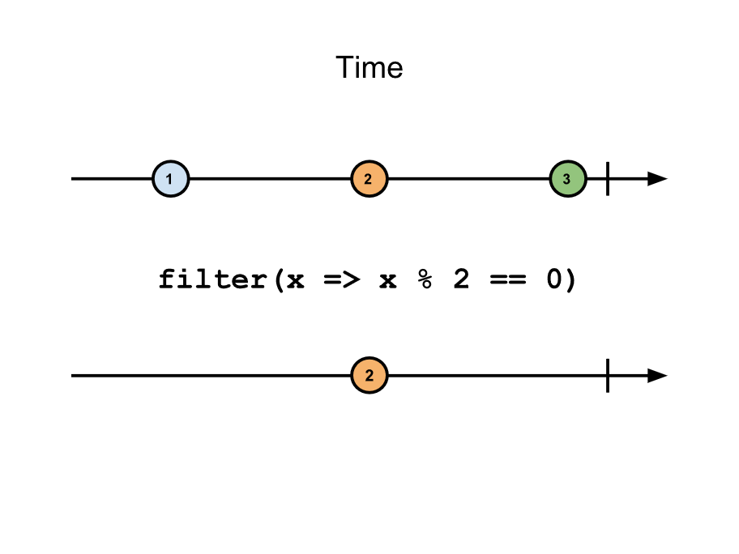
Filter(fn)

Slide 29
forkJoin(obs1, obs2)
Collect the last element emitted by each of the sources into an array and emits this array as its own sole emitted item.
import { Observable } from 'rxjs/Observable‘;
import { forkJoin } from 'rxjs/observable/forkJoin';
let myObservable = of(1);
let otherObservable = of(2);
forkJoin(myObservable, otherObservable);

Slide 30
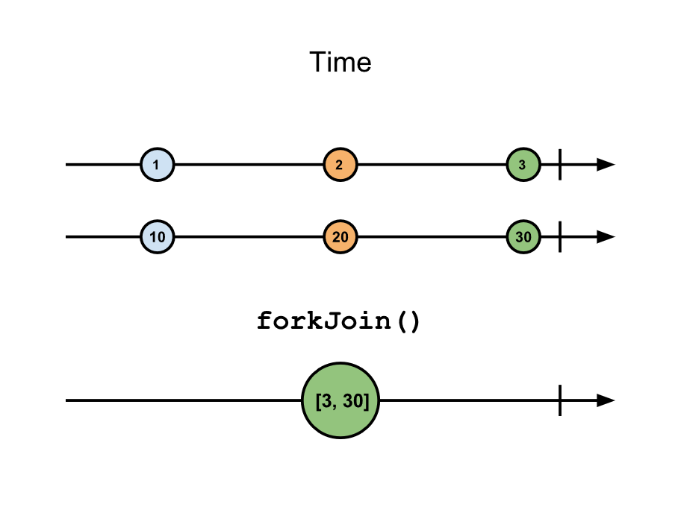
forkJoin(obs1, obs2)

Slide 31
Demo

Slide 32
Tasks

